Slide 1


Protocol Symposium 2025
15-19 September
Protocol School
Cyber-Physical Systems
Protocolized
modeling and verification
prof. Giovanni Merlino
15 September 2025

Slide 2
Agenda
Course summary
Domain topics
Protocolization in action
Prompts
Key takeaways
Action items
Foresight
Future work
Related work

Slide 3
Curriculum: context
Degree course: M.Eng. in Computer Science (2-year)
  direct offshoot of a CPS-oriented “track” which included, at the time, a CSE Ph.D. program in “Cyber-Physical Systems”
    in turn, as an outcome of the infrastructure/automation/embedded systems-orientation, as researchers, of the (core) team of instructors
  in-person, taught in English (cohorts with a 50/50 mix of Italian and international students)
  ~50 students enrolled last year
  frontpage: https://engineering-in-computer-science.cdl.unime.it
  https://unime.coursecatalogue.cineca.it/corsi/2025/10817?annoOrdinamento=2025
My involvement:
  as professor for one first-year subject (see below)
  as international programs head for the degree course
  as deputy head (and curriculum ghostwriter) for the degree course
Subject: Industrial IoT (spring semester, 24x 2-hr classes/labs)
  https://unime.coursecatalogue.cineca.it/insegnamenti/2025/13302/2025/9999/10817?coorte=2025&schemaid=13052

Slide 4
IIoT course: syllabus
Summary (spring ‘26)
  Intro to IIoT/CPS
  Enabling technologies for IIoT
  Service-oriented IIoT
  Industrial communication systems
  CPS modeling
    Digital Twin, Actor model, FSMs
  Hybrid systems
    modal/timed models
    composition
    hierarchy
  Concurrency
    SR, dataflow
  Real-time (basics)
  Safe programming (Rust)
  Middleware
  Design analysis and verification

Slide 5
Background: What is the Internet of Things (aka IoT)
🧠 Core Idea: IoT = Physical Objects + Internet + Intelligence
Devices that sense, communicate, and act — without needing constant human input.
📱Examples You Already Know
Smart thermostats (e.g., Nest)
Wearables (e.g., smartwatches)
Connected cars, fridges, light bulbs
🌍 How It Works
Sensing → Data from the environment (temperature, motion, etc.)
Connectivity → Via Wi-Fi, Bluetooth, 5G, etc.
Processing → Locally (edge) or in the cloud
Action → Alerts, automation, or remote control
⚙️ Why It Matters
Efficiency: Automation saves time and resources
Data-driven insights: Real-time decision making
New capabilities: Smart homes, smart cities, industrial automation
🔐 Also Consider
Security & Privacy: More devices = more risks
Interoperability: Devices need to “speak” the same language
🧩 In One Line: IoT connects the physical and digital worlds to make systems smarter, faster, and more responsive.

Slide 6
Background: What is a Cyber-Physical System, then
🧠 Core Idea: CPS = Physical Systems + Computation + Control + Communication
They don’t just “connect” — they interact with the physical world in real-time.
🔄 How It Differs from IoT
See Table on the right
🏗️ Typical Components
Sensors & Actuators → Measure & act on the physical world
Embedded Computers → Local decision-making, real-time control
Communication Network → Coordinated behavior (wired/wireless)
Control Algorithms → Feedback loops (e.g., PID, MPC)
🚗 Examples in Action
Self-driving cars maintaining lane & speed
Industrial robots assembling parts in sync
Smart grids balancing supply/demand in real time
⚠️ Why It’s Critical
Timing matters: Delays can be catastrophic (e.g., braking system)
Safety-critical: Often (heavily-)regulated (e.g., aerospace, medical devices)
🧩 In One Line: CPS are intelligent systems where software and physical processes are tightly intertwined.
Feature | IoT | CPS
Focus | Connectivity & data | Real-time control & system behavior
Intelligence | Often cloud-based | Often embedded, feedback-driven
Examples | Smart plugs, fitness trackers | Autonomous cars, drones, robotic arms

Slide 7
IIoT course: SoP’25 module development
Design analysis and verification (3-4 classes/labs)
  invariants
  logics
  equivalence/refinement
  simulation/bisimilarity
  reachability analysis
  protocol-pilled modeling and verification/synthesis
    not about “protocols” (i.e., Internet protocols per se), as there’s a whole first half of the course on that!
      not even about (CPS) modeling/verification per se, given it was part of the syllabus already
    more about explicitation of trade-offs, constraints, hidden assumptions (observability, cf. SIGFPT), modeling streamlining (notation/calculi generalizations, Fermi-Dyson shortcuts; again, cf. SIGFPT) and higher-order quantifiers (hyperproperties)
    starting to internalize man-machine interactions in the design phase, at modeling (and model-checking/verification) stage
    trying to state (and improve upon) what is out-of-scope as well (what protocol “is not” about, very hard of course)

Slide 8
Design analysis and verification (current): deep-dive
(hopefully, “vibe-dive” actually)
temporal logics
  e.g., Linear Temporal Logic (LTL)
equivalence/refinement
  type compatibility, language containment
simulation/bisimilarity
  specialization as dual to sim (“matching game”)
  bisim as stronger form of equivalence (e.g., non-deterministic FSMs)
reachability analysis
  safety/liveness (invariants)
  explicit-state/symbolic approaches
modeling and verification/synthesis
  abstractions (vs. refinements; soundness)
  counterexample-guided abstraction refinement (CEGAR)
  automata-theoretic approaches (e.g., liveness, based on Büchi automata)
  (semi)automatic synthesis (specs + examples -> solver + components)
credits: contents here draw heavily from Berkeley’s E. A. Lee textbook “Introduction to Embedded Systems - a Cyber-Physical Systems approach”

Slide 9
A step back: Models of Computation
MoC - semantics of concurrent composition of components
  Components (e.g., Actors), concurrency/communication (mechanisms)
    Actors encapsulate some internal behavioral modeling atom, e.g., FSMs
classes of concurrent MoCs
  Synchronous-Reactive (SR) - still FSM-alike
    feedback, with operating point
  DataFlow (DF) - actor-like only, tokens (vs. state)
    firing rules/actions
    Petri Nets as token-based variant
  Kahn process networks (PN)
    process/token-based, blocking reads, non-blocking writes
  Rendezvous
    blocking writes, basis for
      Communicating Sequential Processes, aka CSP (Tony Hoare)
      Calculus of Communicating Systems, aka CCS (Robin Milner)
        π-calculus
        bigraphs
  Timed (concurrent) MoCs
    Discrete-Event, e.g., DEVS - event-driven (Actor-like)
      non-zero (Moore FSM) state lifespan, timestamped event queue

Slide 10
The engineering perspective: when is a design correct?
when it meets its specification (requirements) in its operating environment
“a design without specification cannot be right or wrong, it can only be surprising!”
(paraphrased, Young et al. 1986)
simply running a few (ad-hoc) tests is not enough!
  many embedded systems are deployed in safety-critical applications (avionics, automotive, medical, …).

Slide 11
Specification, verification, and synthesis
Specification
  a mathematical statement of the design goals - desired properties of the system
Verification
  does the designed system meet prospected goals, in the operating environment?
Synthesis (e.g., of a controller)
  given an incomplete design, generate a strategy that guarantees the system meets its goals

Slide 12
Model-based Design: Verification & Synthesis
Use error trace information to revise model/specs
Model
Verifier
M ⊨ Φ
(does model satisfy specs?)
No
Yes
Requirements
Synthesize system
need for a formal way to write models and requirements (specifications) so that an algorithm can process them

Slide 13
Temporal Logic
a formal way to express properties of a system over time - more precisely, along its time evolution
  e.g., behavior of an FSM (or hybrid system representation)
many flavors of Temporal Logic
  Propositional Temporal Logic
  Real-Time Temporal Logic
  Signal Temporal Logic
  …
Amir Pnueli won ACM Turing Award, in part, for the idea of using temporal logic for specification

Slide 14
Propositional Logic: atoms
Atomic formulas: statements about an input, output, or state of a state machine (at the current time)
Examples:
These are propositions (true or false statements) about a state machine with input or output x and state s
formula | meaning
x | x is present
x = 1 | x is present and has value 1
s | machine is in state s

Slide 15
Propositional Logic: formulas
Propositional logic formulas: more elaborate statements about an input, output, or state of a state machine (at the current time)
Examples:
Here, p₁ and p₂ are propositional logic formulas (which could be atomic formulas)
formula | meaning
p₁ ∧ p₂ | p₁ and p₂ are both true
p₁ ∨ p₂ | either p₁ or p₂ is true
p₁ ⟹ p₂ | if p₁ is true, then so is p₂
¬p₁ | true if p₁ is false

Slide 16
Execution Trace of a State Machine
An execution trace is a sequence of the form
q₀, q₁, q₂, q₃, …
with q_{j} = (x_{j}, s_{j}, y_{j}) where
s_{j} is the state at step j,
x_{j} is the input valuation at step j, and
y_{j} is the output valuation at step j
Alternative notation:
s₀ s₁ s₂
x₀/y₀
x₁/y₁
x₂/y₂
…

Slide 17
Propositional Logic on Traces
A propositional logic formula p holds for a trace
q₀, q₁, q₂, q₃, …
iff it holds for q₀
This may seem odd at first…
… but we will provide temporal logic operators to reason about the trace

Slide 18
Linear Temporal Logic (LTL)
LTL formulas: statements about an execution trace
q₀, q₁, q₂, q₃, …
p here is propositional logic formula and Φ is either a propositional logic formula, or an LTL one
formula | meaning
p | p holds in q₀
GΦ | Φ holds for every suffix of the trace
FΦ | Φ holds for some suffix of the trace
XΦ | Φ holds for the trace q₁, q₂, …
Φ₁UΦ₂ | Φ₁ holds for all suffixes of the trace until a suffix for which Φ₂ holds

Slide 19
LTL mnemonics
LTL formulas: statements about an execution trace
q₀, q₁, q₂, q₃, …
p here is propositional logic formula and Φ is either a propositional logic formula, or an LTL one
formula | mnemonic
p | proposition
GΦ | globally
FΦ | finally, future, eventually
XΦ | next state
Φ₁UΦ₂ | until

Slide 20
LTL operators: G (Globally)
The LTL formula G p holds for a trace
q₀, q₁, q₂, q₃, …
iff p holds for every suffix of the trace:
q₀, q₁, q₂, q₃, …
q₁, q₂, q₃, …
q₂, q₃, …
q₃, …
If p is a propositional logic formula, this means it holds for each q_{i}
note: G p, for propositional formula p, is also termed an invariant (for an execution, i.e., in a stepwise sense)

Slide 21
LTL operators: F (Finally, eventually)
The LTL formula F p holds for a trace
q₀, q₁, q₂, q₃, …
iff p holds for some suffix of the trace:
q₀, q₁, q₂, q₃, …
q₁, q₂, q₃, …
q₂, q₃, …
q₃, …
If p is a propositional logic formula, this means it holds for some q_{i}

Slide 22
Propositional LTL
LTL operators can apply to LTL formulas as well as to propositional logic formulas
e.g., “every input x is eventually followed by an output y”
G(x ⟹ Fy)
Globally
(at any point in time)
it is eventually followed by y
if x occurs

Slide 23
Example LTL formula
The LTL formula G(x ⟹ Fy) holds for a trace
q₀, q₁, q₂, q₃, …
iff for any suffix of the trace where x holds, there is a suffix of that suffix where y holds:
q₀, q₁, q₂, q₃, …
q₁, q₂, q₃, …
q₂, q₃, …
q₃, …
A LTL formula is satisfied by a state machine iff every trace of that state machine satisfies the LTL formula (again, an invariant, but globally)
System ⊨ G p iff ∀traces τ ∈ Traces(System) : τ ⊨ G p
x holds
y holds

Slide 24
Example FSMs
Does the following temporal logic property hold for the state machine below?
G(x ⟹ Fy)
If not, what’s the error trace?
input: x: pure
output: y: pure
x /
a
b
true / y

Slide 25
Example FSMs
Does the following temporal logic property hold for the state machine below?
G(x ⟹ Fy)
If not, what’s the error trace?
input: x: pure
output: y: pure
x /
true /
a
b
true / y

Slide 26
LTL operators: X (neXt)
The LTL formula Xp holds for a trace
q₀, q₁, q₂, q₃, …
iff p holds for the suffix q₁, q₂, q₃, …
q₀, q₁, q₂, q₃, …
q₁, q₂, q₃, …
q₂, q₃, …
q₃, …

Slide 27
LTL operators: U (Until)
The LTL formula p₁U p₂ holds for a trace
q₀, q₁, q₂, q₃, …
iff if p₂ holds for some suffix of the trace, and p₁ holds for all previous suffixes:
q₀, q₁, q₂, q₃, …
q₁, q₂, q₃, …
q₂, q₃, …
q₃, …
p₁ holds
p₂ holds (and maybe p₁ also)
note: a variant, called weak until, written W, does not require p₂ to eventually hold; the U version does

Slide 28
Alternate notation
You’ll find alternative notations in the literature
Most common alternative:
G ☐
F ◊
X ◯

Slide 29
Notable examples
G F p
  p holds infinitely often
F G p
  eventually, p holds henceforth (i.e., forever after)
G ( p ⟹ F q )
  every p is eventually followed by a q
F ( p ⟹ ( X X q ) )
  eventually, at some reaction, either p is false, or p holds and is followed by a q two reactions later

Slide 30
Relationships among operators
G, F, X, U: all express properties along system traces
Can you express G p purely in terms of F, p, and boolean operators?
How about F in terms of U?
What about X in terms of G, F, or U?
G Φ＝¬F ¬Φ
F Φ＝true U Φ
can’t be done

Slide 31
Specs example: robot navigation
obstacles
Φ
Starting
position of robot
Φ = destination for robot
Spec: the robot eventually reaches Φ
suppose now there are n destinations Φ₁, Φ₂, …, Φ_{n}
(new) Spec (could be): the robot visits Φ₁, Φ₂, …, Φ_{n}, in that order

Slide 32
Multi-Robot motion planning from Temporal Logic:
software synthesis
(declarative) task
specs (e.g., LTL)
[+ examples]
(e.g., SMT) solver
component
library
executable software

Slide 33
Exercises: write in LTL
“Whenever the iRobot is at the ramp-edge (cliff), eventually it moves 5 cm away from the cliff”
  p – iRobot is at the cliff
  q – iRobot is 5 cm away from the cliff
“Whenever the distance between cars is less than 2m, cruise control is deactivated”
  p – distance between cars is less than 2m
  q – cruise control is active

Slide 34
Safety and liveness properties
Safety property
  informally, “nothing bad happens” during execution
  formally, execution does not satisfy p iff ∃ finite-length prefix of the execution that cannot be extended to an infinite execution satisfying p (e.g., some violation occurs)
Liveness property
  informally, “something good will happen” (eventually)
  formally, every finite-length execution trace can be extended to an infinite execution that satisfies p (e.g., trivially, FΦ)
  specifies performance or progress requirements
  bounded (F_{≤k}Φ - actually a safety one too!) or unbounded (default)
“Whenever an interrupt is asserted (p₁), the corresponding interrupt service routine (ISR) is eventually executed (p₂)”
  G(p₁ ⇒ Fp₂) - liveness
both can constitute (stepwise) invariants for the system
  e.g., p₁ ⇒ Fp₂ must hold for every state

Slide 35
Considerations on specs
a mathematical specification only includes properties that the system must (or must not) have
it requires human judgment to decide whether that specification constitutes “correctness”
getting the specification right is often as hard as getting the design right!
interesting research directions:
  inferring temporal logic from system traces
    e.g., specification mining
  translating natural language into (temporal) logic
    GenAI to the rescue!

Slide 36
Comparing models
Can we replace one component in a system by another and be assured that the system overall will continue to work correctly?
  Approach: compare models, e.g., state machines, to
    check if component substitution is fine
    check conformance with a specification
    optimize a model by reducing complexity
How can we compare two state machines?
  Equivalence: do they “do the same thing”?
  Refinement: does one “do more” than the other?
    e.g., exhibit different behaviors? produce different outputs?

Slide 37
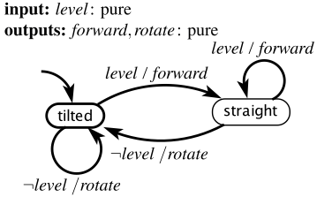
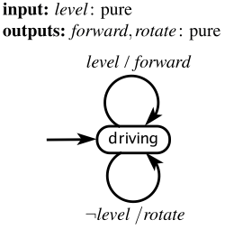
FSM controller for iRobot
assuming a time-triggered FSM:
if the level input is present, then it drives forward for a fixed amount of time by issuing a drive command
if the level input is absent, then it rotates for a fixed amount of time
M₁
alternative FSM:
is machine M₂ equivalent to M₁?
in what sense?
M₂

Slide 38
Type equivalence
actor models for these machines have
  same input ports
  same output ports
ports have
  same types
M₁
therefore M₂ is type equivalent to M₁
M₂

Slide 39
Language equivalence
for every input sequence
the two machines produce the same output sequence
M₁
therefore M₂ is language equivalent to M₁
M₂

Slide 40
Bisimulation as (stronger) equivalence
(very subtle)
for every state of M₁
there is a corresponding state of M₂ that will react to inputs in exactly the same way and will then transition to another similarly corresponding state (and vice-versa)
therefore M₂ is bisimilar to M₁
M₁
corresponding
for deterministic machines
language equivalence and bisimilarity are the same
for nondeterministic machines
they are not
will come back to this! but first, refinement
M₂

Slide 41
Equivalence vs. refinement
Two state machines M₁ and M₂ that are not equivalent may nonetheless be related:
M₂ may be type compatible with M₁ in that it can replace M₁ without causing a type conflict (type refinement)
M₂ may be a specialization of M₁ in that it can produce only output sequences that M₁ can produce, given the same input sequences. (language containment)
M₂ may be a specialization of M₁ in that at every reaction M₂ can produce only output values that M₁ can produce (M₁ simulates M₂) (simulation)
In all cases, if M₁ is “valid” in a system, then so is M₂, where only the meaning of “valid” varies
M₂ is a type/language/simulation refinement of M₁
M₂ implements M₁ (here, M₁ is taken to be a specification)

Slide 42
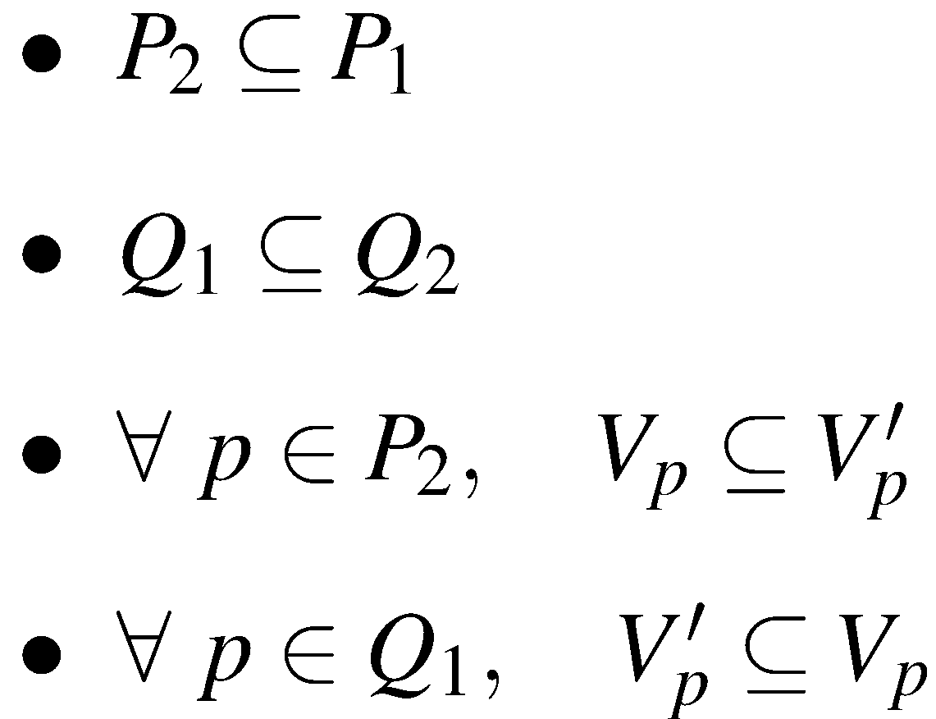
Type refinement
M₂ is a type refinement of M₁ if:
x: V_{x}
y: V_{y}
w: V_{w}
M₁
P₁ = { x, w }
Q₁ = { y }
x: V'_{x}
y: V'_{y}
M₂ can replace M₁ without causing a type conflict
z: V'_{z}
M₂
P₂ = { x }
Q₂ = { y, z }

Slide 43
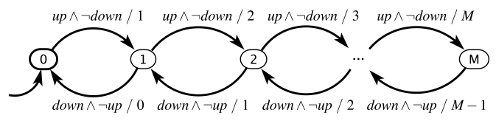
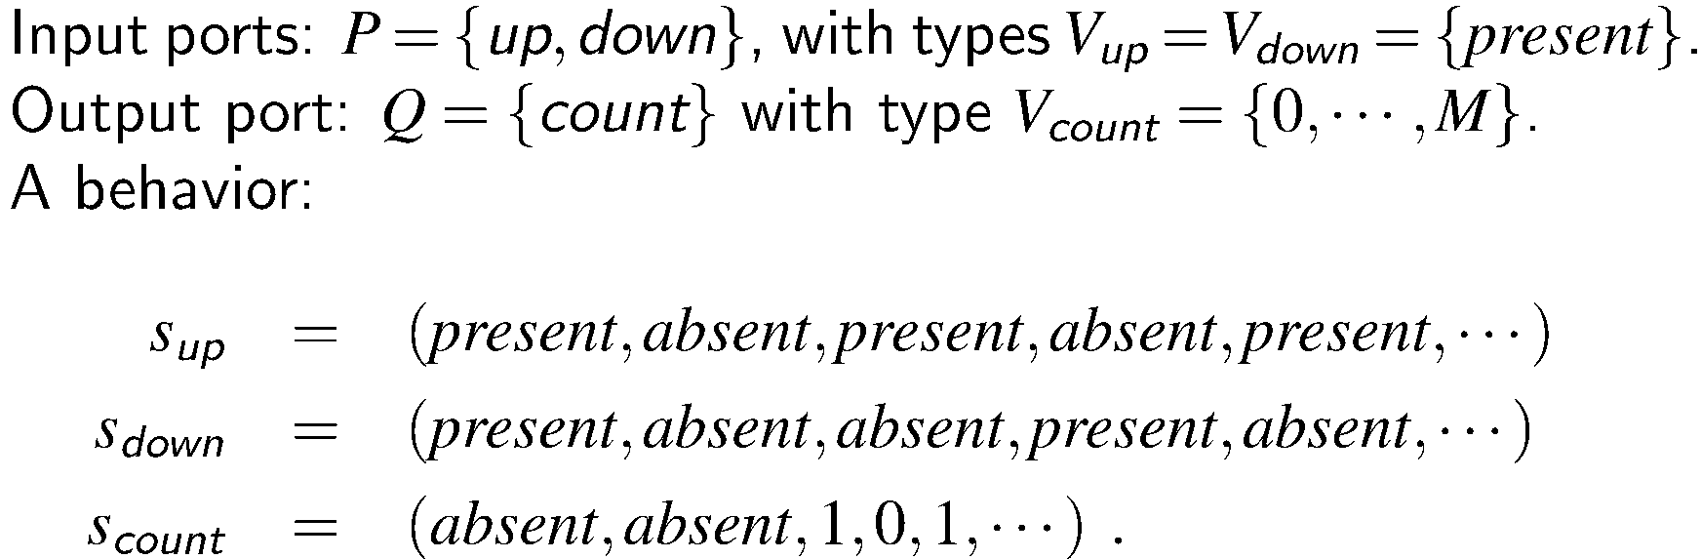
Example: garage counter

Slide 44
Example of type refinement
Consider a garage counter M₁ with M = 99 spaces
Suppose another garage counter M₂ has M = 90 spaces
M₂ is a type refinement of M₁
Is it always OK to replace M₁ with M₂?

Slide 45
Behavior (Execution Trace) of a State Machine
Definition of behavior
  recall: execution trace
  for language refinement, traces comprise only I/O, not states
Consider a port p of a state machine with type V_{p}. This port will have a sequence of values from the set V_{p} ∪ {absent}, one value at each reaction. We can represent this sequence as a function of the form:
s_{p}: ℕ → V_{p} ∪ {absent}
This is the signal received on that port - if it is an input - or produced on that port - if it is an output.
A behavior of a state machine is an assignment of such a signal to each port such that the signal on any output port is the output sequence produced for the given input signals.

Slide 46
Language refinement (containment)
The language L(M) of a state machine M is the set of all behaviors
For type-equivalent state machines M₁ and M₂, M₂ is a language refinement of M₁ if L(M₂) ⊆ L(M₁)
M₂ can replace M₁ if its observable (I/O) behavior is a subset of that of M₁
x: V_{x}
y: V_{y}
M₁
x: V_{x}
y: V_{y}
M₂

Slide 47
Finite sequences and accepting states
By default, FSM executions considered infinite
For the sake of finite executions
  accepting state - typically represented by double-outlined bubble
L_{a}(M): subset of language L(M)
  resulting from executions that terminate in an accepting state
    L_{a}(M) is defined as a language accepted by M
  equivalently, including only behaviors in L(M) with an infinite tail of stuttering reactions that remain in an accepting state
    stuttering - where inputs and outputs are all absent (machine does not change state)
  example of language containment
A behavior in L_{a}(M) specifies for each port p a finite string
  in other terms, a finite sequence of values from the type V_{p}
  for any behavior in L_{a}(M), the accepting state is also the last one
    hence the alternative namesake (final state) for an accepting one

Slide 48
Regular languages and Regular Expressions
A language accepted by an FSM aka as regular language
  language - set of sequences of values from some set called its alphabet
not a regular example: has sequences of the form 0^{n}1^{n}
  sequence of n zeros followed by n ones
regular expression (regex) - (typically, convenient) notation for describing regular languages
  examples of convenience notations - the Kleene star (*)
ω-regular language - generalization of regular languages to infinite executions
  Büchi automata - (possibly nondeterministic) FSMs that have one (or more) accepting states
  The language accepted by the FSM defined as the set of behaviors that visit one or more of the accepting states infinitely often
    in other words, these behaviors satisfy the LTL formula G F(s₁ ∨ ··· ∨ s_{n}), where s₁ ,···, s_{n} are the accepting states
  most modelchecking questions expressed by giving a Büchi (A_{φ}, or BA, or just B) and then checking whether the ω-regular language it defines contains any sequences

Slide 49
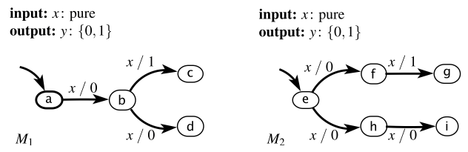
Language equivalence is not enough
Conversely,
Suppose M₂ is the specification (everything it does is OK)
It is not OK to replace it with M₁ because in state b, M₁ is always capable of making a move that M₂ cannot match from state f or state h
Note that these two machines are language equivalent
Yet…
Suppose M₁ is the specification (everything it does is OK)
It is fine to replace it with M₂ because at each step, any move M₂ can make is OK (because any move M₁ can make is OK)
There is a context in which M₁ is not a valid replacement for M₂

Slide 50
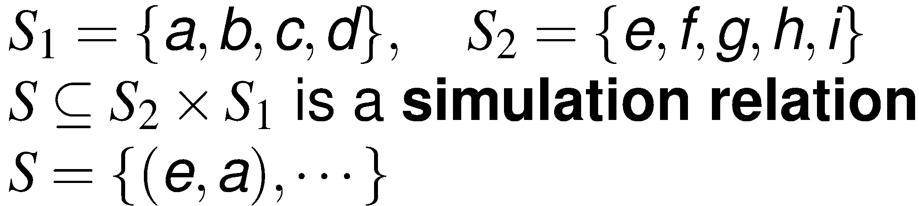
Simulation relation: the “matching” game
M₁ simulates M₂
Game: each machine starts in its initial state
M₂ moves first

Slide 51
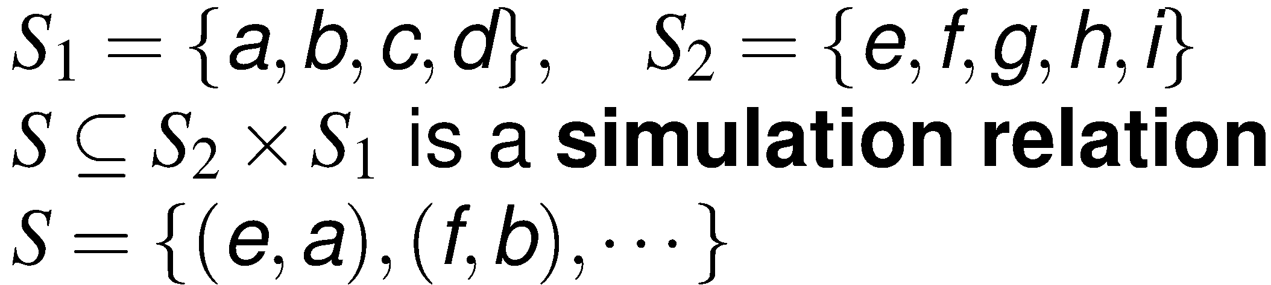
Simulation relation: the “matching” game
first possibility
M₁ simulates M₂
Game: M₂ moves first, and then M₁ matches the move
M₂ moves first

Slide 52
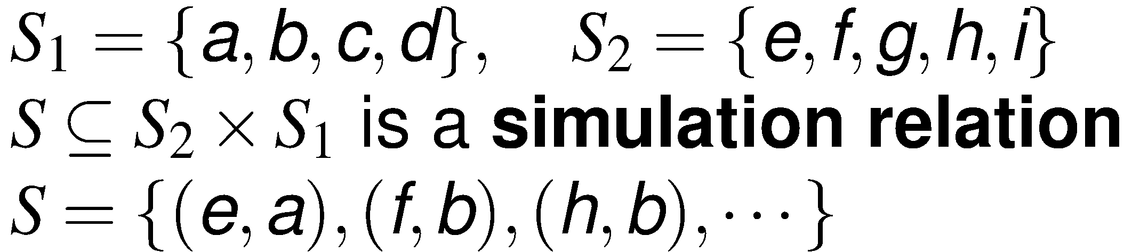
Simulation relation: the “matching” game
second possibility
M₁ simulates M₂
Game: “matching” the move - same input, same output
M₂ moves first

Slide 53
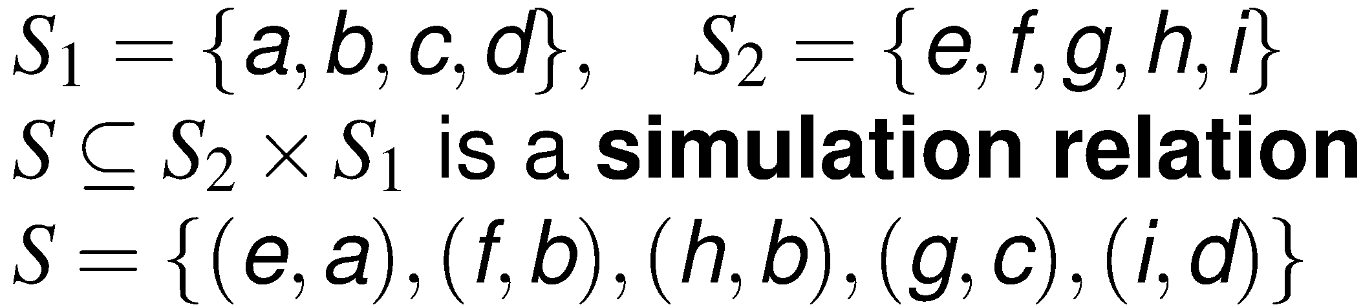
Simulation relation: the “matching” game
M₁ simulates M₂
Game: get to all reachable states of M₂
M₂ moves first
the simulation relation

Slide 54
Simulation relation: the “matching” game
Since M₁ simulates M₂, M₂ refines M₁, M₂ can replace M₁, everywhere M₁ is OK, so is M₂

Slide 55
When is replacement acceptable?
The two machines are “equivalent”
  how to define equivalence?
For deterministic machines
  language refinement
For nondeterministic machines
  simulation

Slide 56
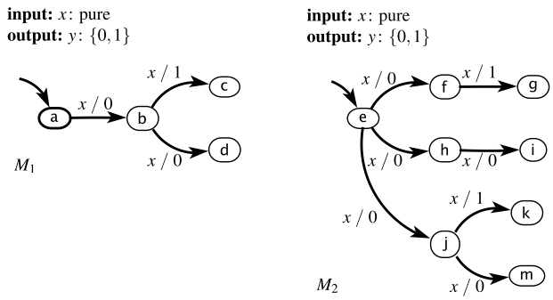
Bisimulation
type equivalent and, when playing the game, on each move, either machine can move first, and the other machine can match its move
can have two machines simulating each other that are not bisimilar
M₁ simulates M₂ and viceversa, but they are not bisimilar

Slide 57
Simulation and trace containment
Theorem: if M₁ simulates M₂, then L(M₂) ⊆ L(M₁)
Note: if L(M₂) ⊆ L(M₁), it is not necessarily the case that M₁ simulates M₂

Slide 58
Replacement summary
M₂ is a type refinement of M₁:
M₂ can replace M₁ without causing a type conflict
M₂ is a language refinement of M₁:
M₂ can produce only output sequences that M₁ can produce, given the same input sequences
M₂ is a simulation refinement of M₁:
(equivalently, M₁ simulates M₂ )
at every reaction, M₂ can produce only outputs that M₁ can produce
M₂ is bisimilar to M₁:
at every reaction, either machine can produce only outputs that the other can produce
In all cases, if M₁ is “valid” in a system, then so is M₂, where only the meaning of “valid” varies. Alternative terminology:
M₂ implements M₁ (here, M₁ is taken to be a specification)

Slide 59
Reachability analysis and model checking
Reachability analysis
  computing the set of reachable states for a system
    to verify whether a desirable outcome (goal, state) is reached
    aid in solving dependability problems
Model checking
  algorithm to determine if a system satisfies a formal specification
    e.g., expressed in temporal logic
  typically, involving reachability analysis

Slide 60
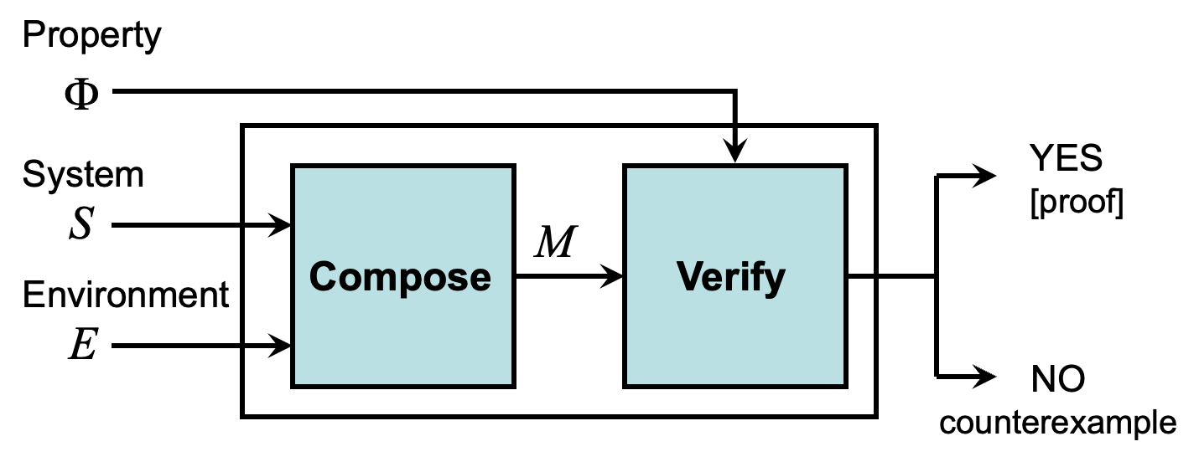
Formal verification

Slide 61
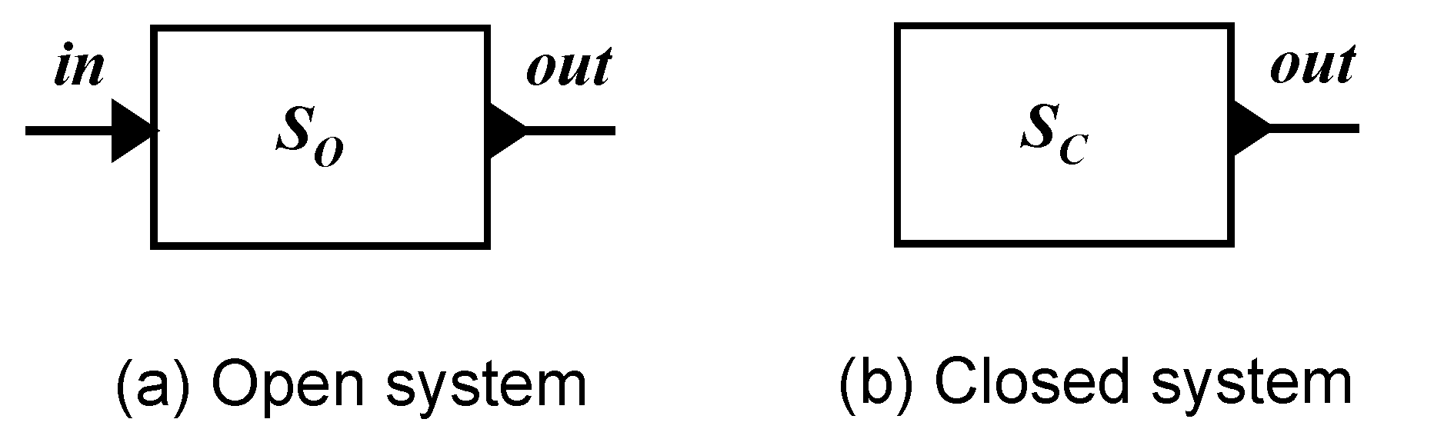
Open vs. closed systems
A closed system is one with no inputs
For verification, we obtain a closed system by composing the system and environment models

Slide 62
Model checking G p
Consider an LTL formula of the form G p where p is a proposition
a property on a single state
To verify G p on a system M, one simply needs to enumerate all the reachable states and check that they all satisfy p
the state space found is typically represented as a directed graph called a state graph
When M is a finite-state machine, this reachability analysis will terminate - in theory
in practice, though, the number of states may be prohibitively large, consuming too much runtime or memory (the state explosion problem)

Slide 63
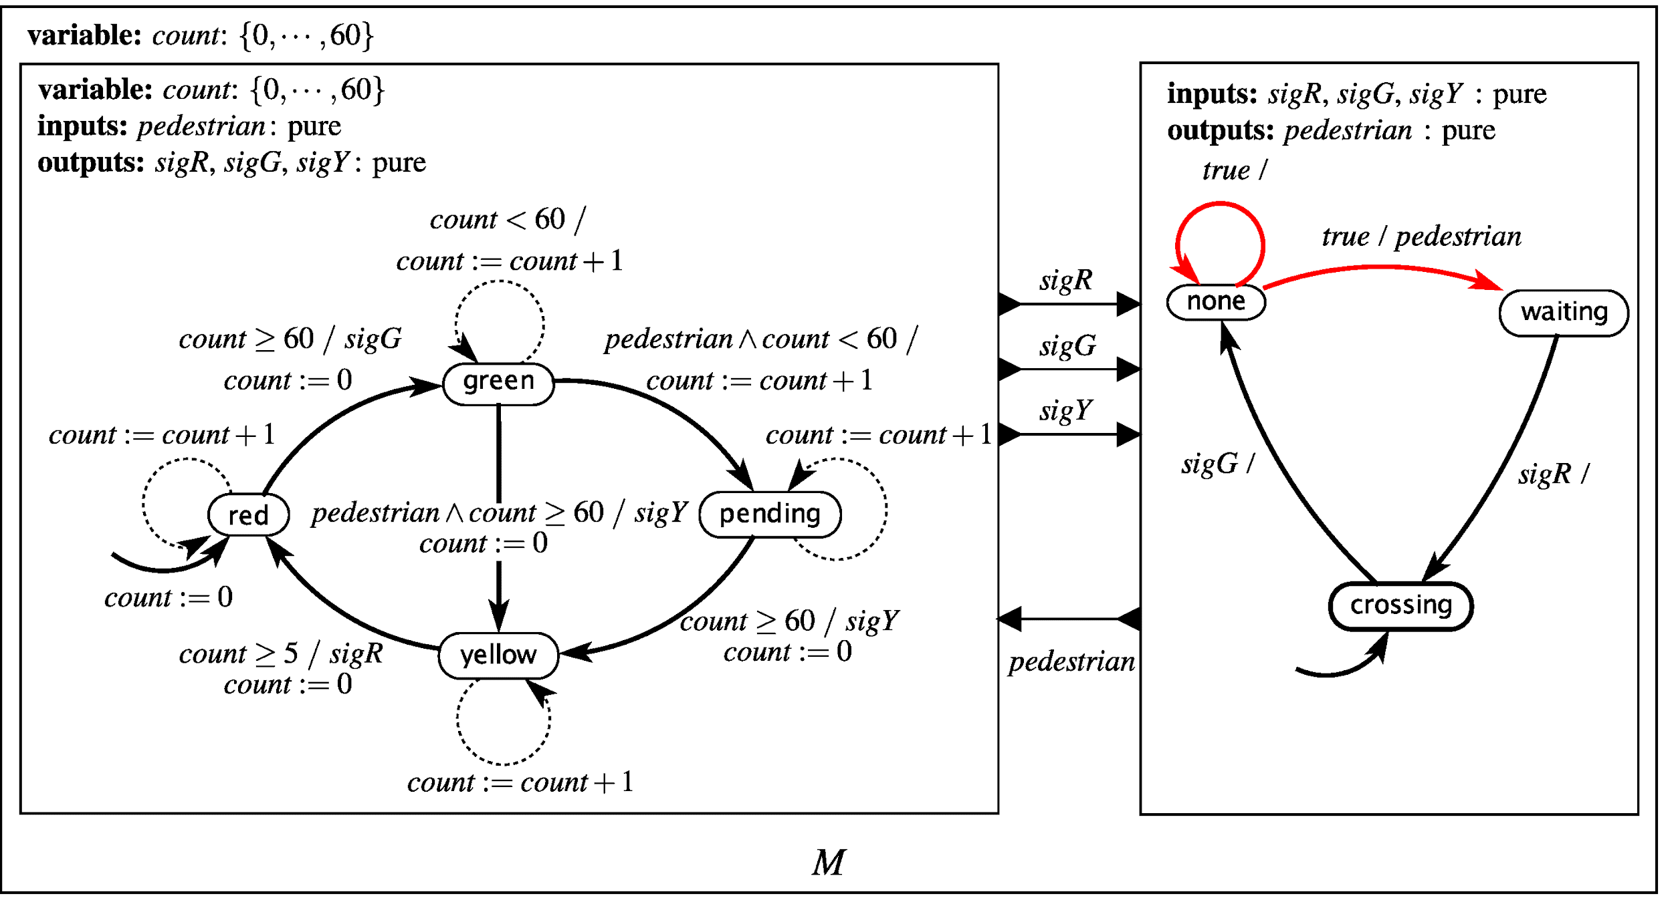
Traffic light controller example
Property: G ( ¬( green ∧ crossing ) )

Slide 64
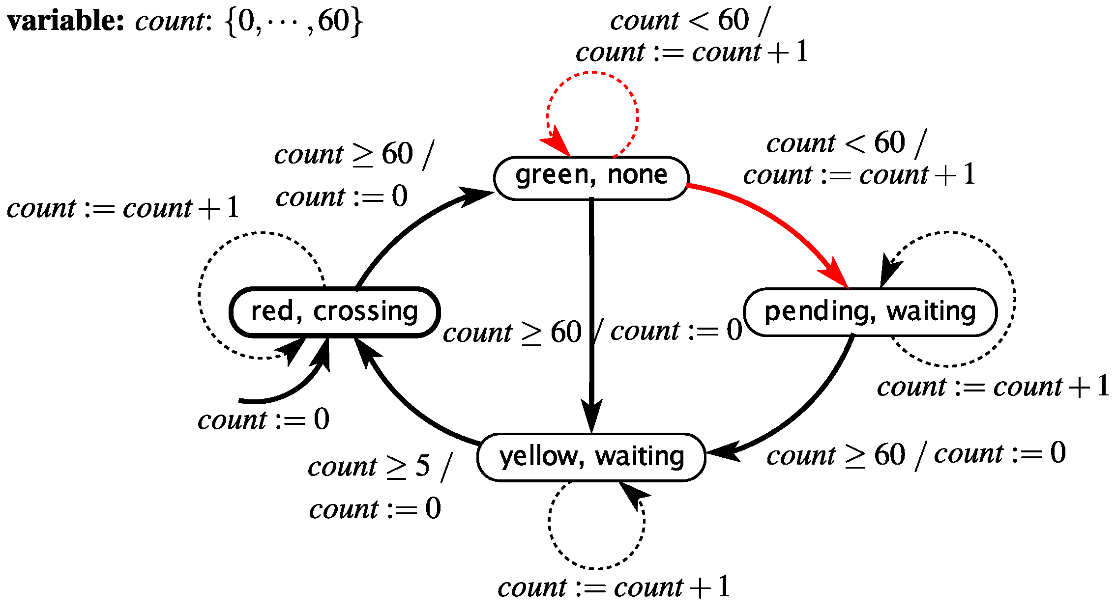
FSM composition for the traffic light controller
Property: G ( ¬( green ∧ crossing ) )
This FSM has 188 states - accounting for different values of count

Slide 65
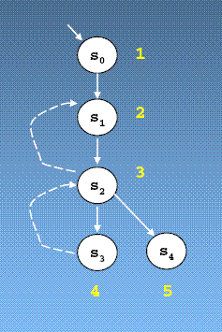
Reachability through graph traversal
Construct the state graph on the fly
Start with initial state, and explore next states using a suitable graph-traversal strategy
Example: DFS
  Maintain 2 data structures:
    Set of visited states R
    Stack with current path from the initial state

Slide 66
Generating counterexamples
If the DFS algorithm finds the target (“error”) state s, how can we generate a trace from the initial state to that state?
Simply, read the trace off the stack!
s₀
Stack:
s₁
s
s₁
s
s₀

Slide 67
Explicit-state modelchecking
Property: G ( ¬( green ∧ crossing ) )
R = {(red, crossing, 0), (red, crossing, 1), … (red, crossing, 60), (green, none, 0), (green, none, 1), … (green, none, 60), (yellow, waiting, 0), … (yellow, waiting, 5), (pending, waiting, 1), … (pending, waiting, 60)}
R = {(red, crossing, 0), (red, crossing, 1), … (red, crossing, 60), (green, none, 0), (green, none, 1), … (green, none, 60), (yellow, waiting, 0), … (yellow, waiting, 5), (pending, waiting, 1)}
R = {(red, crossing, 0), (red, crossing, 1), … (red, crossing, 60), (green, none, 0), (green, none, 1)}
R = {(red, crossing, 0), (red, crossing, 1)}
R = {(red, crossing, 0), (red, crossing, 1), … (red, crossing, 60), (green, none, 0), (green, none, 1), … (green, none, 60), (yellow, waiting, 0), … (yellow, waiting, 5)}
R = {(red, crossing, 0)}
R = {(red, crossing, 0), (red, crossing, 1), … (red, crossing, 60), (green, none, 0)}
R = {(red, crossing, 0), (red, crossing, 1), … (red, crossing, 60), (green, none, 0), (green, none, 1), … (green, none, 60), (yellow, waiting, 0)}
R = {(red, crossing, 0), (red, crossing, 1), … (red, crossing, 60)}
R = {(red, crossing, 0), (red, crossing, 1), … (red, crossing, 60), (green, none, 0), (green, none, 1), … (green, none, 60)}

Slide 68
Symbolic approaches
Rather than exploring new reachable states one at a time, we can explore new sets of reachable states
however, we only represent sets implicitly, as Boolean functions
Set operations can be performed using Boolean algebra
represent a finite set of states S by its characteristic Boolean function f_{S}:
f_{S} (x) = 1 iff x ∈ S
Similarly, the state transition function δ yields a set δ(s) of next states from current state s, and so can also be represented using a characteristic Boolean function for each s
Example: BFS
  generate the state graph by repeated application of transition function (δ)
    if the goal state reached, stop & report success
    else, continue until all states are seen

Slide 69
Symbolic approach example
Property: G ( ¬( green ∧ crossing ) )
R, set of reachable states,
represented by:
(ν₁ = red ∧ ν₂ = crossing ∧ 0 ≤ count ≤ 60)
(ν₁ = red ∧ ν₂ = crossing ∧ 0 ≤ count ≤ 60) ∨ (ν₁ = green ∧ ν₂ = none ∧ 0 ≤ count ≤ 60) ∨ (ν₁ = pending ∧ ν₂ = waiting ∧ 1 ≤ count ≤ 60)
(ν₁ = red ∧ ν₂ = crossing ∧ 0 ≤ count ≤ 60) ∨ (ν₁ = green ∧ ν₂ = none ∧ 0 ≤ count ≤ 60) ∨ (ν₁ = pending ∧ ν₂ = waiting ∧ 1 ≤ count ≤ 60) ∨ (ν₁ = yellow ∧ ν₂ = waiting ∧ count = 0)
(ν₁ = red ∧ ν₂ = crossing ∧ 0 ≤ count ≤ 60) ∨ (ν₁ = green ∧ ν₂ = none ∧ 0 ≤ count ≤ 60) ∨ (ν₁ = pending ∧ ν₂ = waiting ∧ 1 ≤ count ≤ 60) ∨ (ν₁ = yellow ∧ ν₂ = waiting ∧ 0 ≤ count ≤ 5)
(ν₁ = red ∧ ν₂ = crossing ∧ 0 ≤ count ≤ 1)
(ν₁ = red ∧ ν₂ = crossing ∧ 0 ≤ count ≤ 60) ∨ (ν₁ = green ∧ ν₂ = none ∧ count = 0)
(ν₁ = red ∧ ν₂ = crossing ∧ count = 0)
(ν₁ = red ∧ ν₂ = crossing ∧ 0 ≤ count ≤ 60) ∨ (ν₁ = green ∧ ν₂ = none ∧ 0 ≤ count ≤ 1) ∨ (ν₁ = pending ∧ ν₂ = waiting ∧ count = 1)

Slide 70
Abstraction in modelchecking
Should use simplest model of a system that provides proof of safety
Simpler models mean
  smaller state spaces
    easier to check
The challenge is to know which details can be abstracted away
  a simple and useful approach is called localization abstraction
    a localization abstraction hides state variables that are irrelevant to the property being verified
    still a major challenge to automatically compute simple abstractions
      typically tackled with strategies such as CounterExample-Guided Abstraction Refinement (CEGAR)

Slide 71
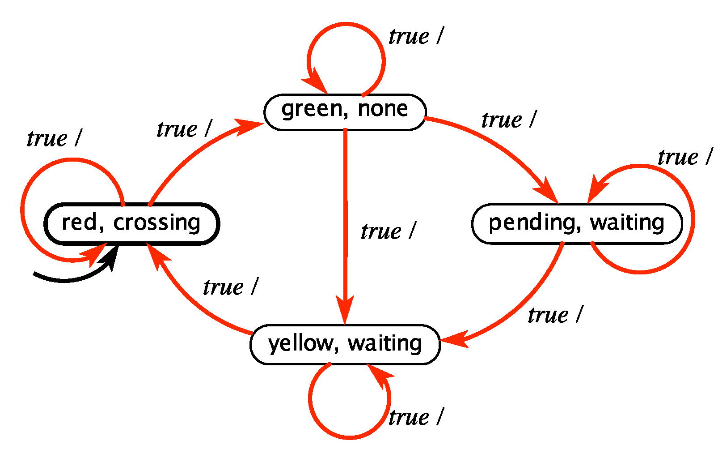
Abstraction example
Property: G ( ¬( green ∧ crossing ) )
what’s the hidden variable?

Slide 72
Modelchecking liveness properties
Let’s recall:
Safety property
  informally, “nothing bad happens” during execution
  formally, execution does not satisfy p iff ∃ finite-length prefix of the execution that cannot be extended to an infinite execution satisfying p (e.g., some violation occurs)
    has finite-length counterexamples
Liveness property
  informally, “something good will happen” (eventually)
  formally, every finite-length execution trace can be extended to an infinite execution that satisfies p (e.g., trivially, FΦ)
    only has infinite-length counterexamples
  more involved than simply doing a reachability analysis
    e.g., automata-theoretic approach to verification
      ¬Φ = B —> B ⊗ M = M_{B}
      M_{B} visits an accepting state infinitely often —> M ⊯ Φ
        otherwise, M ⊨ Φ

Slide 73
Use case: sequence-of-(random-)pickings
Suppose we have a Robot that must pick up multiple things, in any order
Φ_{i} = robot picks up item i, where 1 ≤ i ≤ n
How would you state this goal in temporal logic?
Goal to be achieved is:
FΦ₁ ∧ FΦ₂ ∧ … ∧ FΦ_{n}

Slide 74
Use case: sequence-of-(ordered-)pickings
Suppose we have a Robot that must pick up multiple things, in a specified order
Φ_{i} = robot picks up item i, where 1 ≤ i ≤ n
How would you state this goal in temporal logic?
Goal to be achieved is:
F(Φ₁ ∧ F(Φ₂ ∧ … ∧ FΦ_{n})…))

Slide 75
Controller synthesis
Consider the first part alone:
F(Φ₁ )
How can we use model checking to synthesize a control strategy?
  recall that F(Φ₁ ) = ¬G(¬Φ₁ )
Therefore, we can construct a counterexample to:
G(¬Φ₁ )
The counterexample is a trace that gets the robot to the desired point

Slide 76
Domain background: wrap-up (I)
🔄 LTL → Automata
LTL formulas are not FSMs, but they can be compiled into automata (typically nondeterministic Büchi automata, NBA).
This allows you to compare the system FSM against the property, since both are now automata.
🧩 Checking
System FSM (Kripke structure, transition system).
Spec LTL φ → NBA Aφ that accepts exactly the traces satisfying φ.
Product: system × A¬φ (the automaton for the negation of the spec).
  If product accepts a trace → counterexample (spec violated).
  If not → system ⊨ φ.
👉 Here “comparison” means:
Does the language of system traces ⊆ language defined by spec automaton?

Slide 77
Domain background: wrap-up (II)
🛠️ Synthesis
Start with LTL spec φ.
Translate φ into a Büchi automaton (or deterministic parity automaton if needed).
Treat environment vs. controller as a two-player game on the automaton:
  States partitioned into system choices vs environment choices.
  Winning condition = satisfying φ.
Solve the game → extract controller FSM that ensures φ.
👉 Here “substitution” means:
The synthesized controller FSM is inserted into the system FSM so that all resulting behaviors are in L(φ).
🔍 Comparison / Substitution in LTL Context
Comparison:
System FSM compared against Spec Automaton (language containment).
Substitution:
If FSM C1 ensures φ in a system S, and C2 simulates/refines C1, then replacing C1 with C2 keeps φ satisfied.

Slide 78
Domain background: wrap-up (III)
This is the logic → automata → FSM chain:
LTL formula φ
↓
automaton Aφ
↓
compare/substitute with
↓
system FSM(s)
🌐 Intuition
LTL itself is declarative (“eventually this holds”, “always that holds”).
FSMs are operational (states, transitions).
The bridge is automata theory: you lower specs to FSM-like structures so that comparison/substitution is well-defined.

Slide 79
What protocolizing may look like
🧠 Core Idea: Protocolizing = Making interactions explicit, structured, and verifiable
Devices, systems, and humans follow rules of engagement — like roles in a play.
🔧 Why Protocols?
Coordination: Who does what, when, and under what conditions
Scalability: From devices to swarms to whole infrastructures
Accountability: Traceable actions, auditability, compliance
Safety: Preventing unintended or unsafe behavior
🕸️ Examples of Protocolizing in Practice
Machine-to-machine handover in smart manufacturing (e.g., conveyor → robot)
Negotiation protocols for resource sharing in edge computing
Human-in-the-loop protocols for emergency overrides, e.g., killswitches
Formal contracts for service-level guarantees in IIoT platforms
📐 Tools & Models
Finite State Machines (FSMs): For device behavior
Linear Temporal Logic (LTL): For safety/liveness guarantees
Interaction Protocols: Like session types or smart contracts
Digital Twins: As protocol-bound system mirrors
🌍 Big Picture: Protocolizing is how decentralized, heterogeneous systems can behave as one, safely and predictably — especially when humans, robots, and infrastructure must interact.
🧩 Protocolizing turns implicit behavior into explicit interaction patterns — enabling coordination, verification, and trust.

Slide 80
Proposal: protocolized CPS engineering
🛠️ What does protocolizing CPS engineering mean?
🔧 Explicit coordination rules – turn tacit “best-effort” habits into codified steps
⚙️ Technical focus – latency, safety margins, failure modes
💶 Economic focus – cost, energy, throughput, ROI
👥 Human / social focus – trust, acceptance, workload, override rights, delegation
🗂️ Protocols = socio-technical contracts – designed, verified, enforced, and evolved (versioned artifacts)
  explicit choreography of all actors (performers)
🎯 Applied to IoT/CPS to keep thousands of devices (and people) aligned & adaptive
  evolvability to account for drift (of goals, tensions, operations, etc.)
    « the “heterogony of ends” formulates that an ongoing behavioral sequence must often be understood in terms of ever-shifting patterns of primary and secondary goals »

Slide 81
Examples: (FSM) modeling (robo-vacuumcleaner)
Idle
StartReq
Check A
Fail A
Reset
OK
Fail B
Check B
OK
Sweeping
Cycle Complete
High Kafka Index (worst-case protocolization, overcautious safety)

Slide 82
Examples: revised (non-Kafka) model
c < N
Idle
StartReq
Check A
Fail A
Reset
c = N
c := 0
c := c++
OK
Fail B
Escalate
Check B
c := c++
OK
Sweeping
OR
Cycle Complete
Low Kafka Index (human-in-the-loop, escalation path)

Slide 83
Reframing Hypersafety vs. Liveness as level-0 tension (T₀)
🔹 Level 0 – One Agent, One Protocol… & Tension
🧠 Single robotized vacuum-cleaner FSM: Idle → Check → Sweep → Retry/ Escalate.
🛡️ Hypersafety: G(running → checksOK) – never, ever, run under unsafe conditions.
⏳ Liveness: G(startrequest → F(running ∨ escalated)) – every request must finish.
⚠️ Tension: strict checks ↑ safety, but risk infinite loops ↓ progress.
🛠️ Engineering trade-off: pick N retries before escalation.
🤝 Social dimension: who flips the killswitch or approves override?
📐 Meta-modeling exposes this trade-off, making it explicitly analysable.

Slide 84
Proposal (updated): Meta-modeling (MM)?
🧠 What may meta-modeling mean in this context
🧩 Meta-modeling → Modeling how we model — abstracting the structure of the modeling frameworks themselves.
Useful to design reusable and composable protocol layers.
🪜 A protocol modeling stack:
🌀 FSMs — capture local agent logic (e.g., a single roboVC’s behavior).
⚖️ LTL / CTL — specify global system properties (e.g., safety, liveness, fairness).
🔭 Protocolization across levels
🔹 Level 0: Single agent
FSM (Idle, Sweep...)
LTL: G(¬collision), F(charge)
🔸 Level 1: Autonomous/agentic swarm
Protocols for coordination, task allocation, bounded latency
🏙️ Level 2: Smart city
Humans + Robots → social protocols, priority rules, override paths
💡 Why meta-model?
Encapsulate patterns across layers
Enable automated validation, synthesis, simulation
Ground for protocol composition & governance

Slide 85
MM: T₁ (Fairness vs. Throughput)
🔸 Level 1 — Swarm Coordination, One Shared Dock
🧑‍🤝‍🧑 Scenario 3 roboVCs share one charging dock while cleaning a hallway grid.
🌀 Local FSM (each bot) Sweep → RequestDock → Wait / Charge → Resume.
🎟️ Coordination Protocol “Token-at-Dock” — only the bot holding the virtual token may enter the dock zone.
🛡️ Global safety G(¬(inDock_{i} ∧ inDock_{j})) → no two bots dock simultaneously.
⏳ Bounded liveness G(Request_{i} → F_{≤3} Charge_{i}) → every bot docks within 3 token passes.
⚖️ Tension Fairness vs. throughput: short token window ↑ fairness, long window ↑ overall uptime.
🔧 Engineering lever Adjust token-hold time; add priority boost if battery < 15 %.
📐 Meta-model link Swarm protocol = Level-0 FSM + an extra “token” layer; verified once, reused for any N-bot fleet.

Slide 86
MM: T₂ (Acceptance vs. Efficiency)
🏙️ Level 2 — Smart-City Interaction: Swarms + People
🏗️ Scenario Autonomous delivery carts share a pedestrian crosswalk with humans.
🤖 Robot FSM Approach → RequestCross → Wait / Cross → Resume.
🚶 Human interface pressure sensor + vision ⇢ “pedestrian onCrosswalk” flag.
🛡️ Safety G(pedOnCrosswalk → ¬cartInCrosswalk) → robots never enter if a person is present.
⏳ Responsiveness G(cartReq → F_{≤20} cartCross) → each cart crosses within 20 s unless human flow is continuous.
⚖️ Tension Pedestrian priority ↑ social acceptance; too much priority ↓ logistics throughput.
🧑‍⚖️ Governance layer City policy toggles “rush-hour mode” (longer human green), or “night mode” (robot priority).
🔧 Engineering levers Adaptive timeout, dynamic queue merging, audible human cue.
📐 Meta-model link Level-2 model = (Level-1 token logic) + policy layer; verified once, deployed to every smart crossing.

Slide 87
Prompts for you (and your GenAI): vibe-modeling!
Design a Micro-Protocol (FSM)
  Tool: https://madebyevan.com/fsm/
  Design an FSM for a coffee-sharing robot.
  States: Idle / Brewing. Input: Request
  Add one safety and one liveness property.
  How would it scale to 2 agents?
Bisimilarity Game
  Create 2 bisimilar FSMs with different shapes.
  Then, slightly change one to break bisimilarity.
  What does the change represent in protocol terms?
  Can you refactor them back to equivalence?
What Can’t You Model?
  Name a real-life protocol you follow.
  Why can’t it be modeled with FSM + LTL?
  Is it due to ambiguity, hidden state, or agency?
  Should it be made explicit — or remain implicit?
Hyperproperty Hack
  Define two valid runs (G p) that together violate fairness.
  Is this a bug or feature?
  Can LTL capture it? Or do you need HyperLTL?
  What does this say about coordination and trust?
more here: https://docs.google.com/document/d/1DzvnsMzFkEFj_1LLG4X4RuBPn5hr0HfKDQnxgUW4A4E/edit?usp=sharing

Slide 88
Wrap-up & Key Takeaways
🔧 Protocolization = explicit coordination rules on Technical • Economic • Social axes.
🔭 “Telescopic” view:
  Level 0 🟢 single agent (e.g., roboVC)
  Level 1 🔹 swarm with shared resources
  Level 2 🏙️ city-scale robots + people + policy
⚖️ Tension themes: e.g., Hypersafety (never unsafe) ↔ Liveness (always progress).
  resolved by, e.g., bounded retries, tokens, adaptive policies.
🧩 Meta-modeling stack: FSMs → LTL/CTL — enables reuse, automated verification, safe evolution.
🛑 Governance hooks: killswitches, escalation paths, civic-policy overlays.
🚀 Next steps: prototype, model-check, iterate sprints for assignments — then potentially ready to deploy protocols that scale from device to city.

Slide 89
Action items (for module development)
Keep engaging in the Formal Protocol Theory (FPT) working group
  definitely on the same wavelength with topics in my course
Further develop the module (materials, labs)
  revisi(ti)ng the current contents where needed
  extending topic coverage with first-class protocol-pilling constructs, i.e., possibly out of our joint FPT meanderings
    definitely bordering close to research
  coming-up with one (or more) full-stack running examples
Explore tie-ins with other disciplines, including non-STEM ones
  starting from this discussion/wrap-ups, among other things as a way to
    contaminate the framework(s) for modeling (with, e.g., governance/risk layers “encoding”)
    factor-in the human (as agent in a CPS environment) aspects

Slide 90
Foresight
Big elephant in the room: AI/ML - w/ LLMs as (current) rising stars
role, especially in education, cannot be underestimated
yet, most outcomes possibly on the positive side
  in edu, outside the (proctoring) box/mindset, huge room for (self-)improvement/assessment, for the daring ones
  final assessments, otoh, requiring much higher care/engagement from the evaluators
    along GenAI parlance, the chain-of-thought/reasoning chops going to be central; notion-based evaluation - already overrated - now basically over
  good news for academy at large, the value of educator-to-student interaction - even more so, in-presence - not going away, anytime soon
    on the other hand, stubbornly being stuck in the “olden” ways of delivery - bulletproof recipe for failure

Slide 91
Foresight (cont’d)
GenAI impact on my field:
CS seemingly disrupted at all levels
CS engineering (“CSE”) possibly even more so, considering:
  engineering, whichever the domain, always been about iterating (“gravitating”) toward a (presumably, imperfect/limited-scope) solution
    never about definitive answers about anything - as a matter of fact, looking no further than the “engineered argument” definition
  generative machinery bound to boost the “centaur” effect in engineering design activities
    and agentic approaches are going to carry a great deal of additional “tension” - as well as explorative leeway - due to the (approximating human-like) “agency” factor
  in the end, for all their worth and impact, even GenAI (or AGI), may take a totally different shape - may be my bias, yet highly likely in my book, see LeCun and Gary Marcus alt-AI/ML takes

Slide 92
Future work
Hopefully, embracing protocol studies going forward, across a number of trajectories:
exploring second-order effects of the modeling activity
looking forward to adapt other syllabi, e.g., my Bachelor’s Software Engineering course - fall ‘27 onwards, to the “protocol treatment”
hopefully expand soon coverage of protocolized CPS in literature
  possibly for the 2nd edition, or follow-up, to ASCPS¹ book (out 2026)
planning to instigate a few research trails out of this (ongoing) conversation - postdocs and interns alerted!
envisioning to leverage a number of opportunities to evangelize (in the sense of “protocol-pill”) during public outreach initiatives
https://books.google.it/books/about/Assembling_Smart_Cyber_Physical_Systems.html?id=_6smEQAAQBAJ

Slide 93
Related work
The Protocol Reader collection of kickstart essays
Special Interest (Working) Group on Formal Protocol Theory (SIGFPT) and its contributions (topics, conversations, bibliographies) with its grand-unification “push”
… a growing list of references, too long to be listed here
  special mention to the “bunnytrail” Milner’s work on Ubiquitous Abstract Machines - in a nutshell, a generalization of CCS and π-calculi through bigraph-based modeling - definitely on my radar,
  Nathan Schneider’s Contributions to a Glossary of Protocol,
  and to the Cosmopolis overarching framework
    especially when it comes to the role of tech (IoT/BC/AI) as memories across “logics”, and (historical/collective) memory overall as an “articulated” hyperobject

Slide 94

Questions & Discussion
🙏 Thanks for your attention!
❓ Q&A: Happy to answer your questions,
📬 Contact: Giovanni Merlino — gmerlino@unime.it
🌐 More to come (materials, etc)
  over the course of the spring semester

